Slide 1
Tutorial 2 Developing a Web Site

Slide 2
Formatting Lists
List marker – It is the default browser style symbol displayed before each list item for unordered and ordered lists
To change the type of list marker or to prevent any display of a list marker, use
list-style-type: type;
where type is the various types of markers

Slide 3
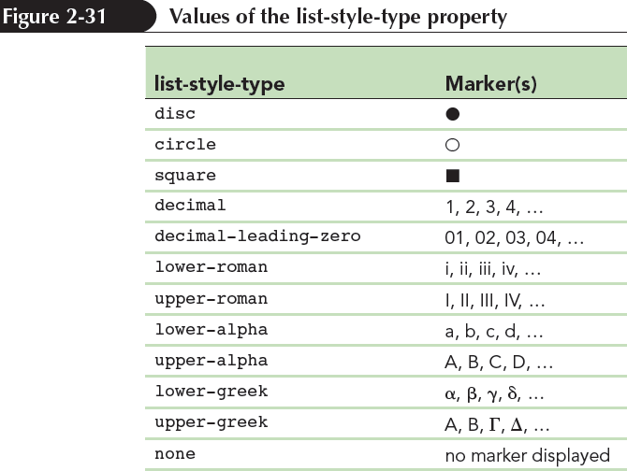
Formatting Lists

Slide 4
Creating an Outline Style
ol{
list-style-type: upper-roman;
}
ol ol{
list-style-type: upper-alpha;
}
ol ol ol{
list-style-type: decimal;
}

Slide 5
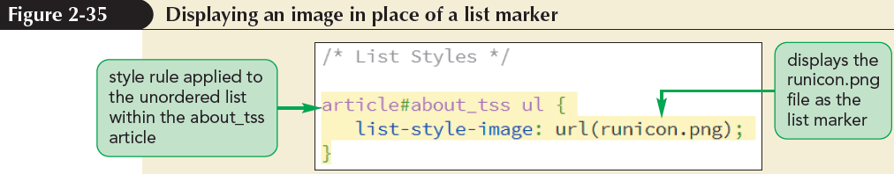
Using Images for List Markers
A customized graphic image for the list marker can be supplied by the user
list-style-image: url (url);
where url is the URL of a graphic file containing the marker image

Slide 6
Setting the List Marker Position
CSS treats each list item as a block-level element, placed within a virtual box in which the list marker is placed outside of the list text
To change the default behaviour, use
list-style-position: position;
where position is either outside or inside

Slide 7
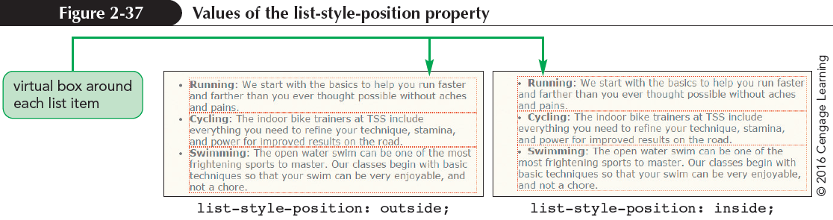
Setting the List Marker Position

Slide 8
Setting the List Marker Position
All three of the list styles can be combined using the following shorthand
list-style: type image position;
Example
ul{
list-style: circle url(bullet.png) inside;
}

Slide 9
Working with Margins and Padding
Block-level elements follow the structure of the box model
Contents in a box model are enclosed within the following series of concentric boxes:
The content of the element itself
The padding space, which extends from the element’s content to a border

Slide 10
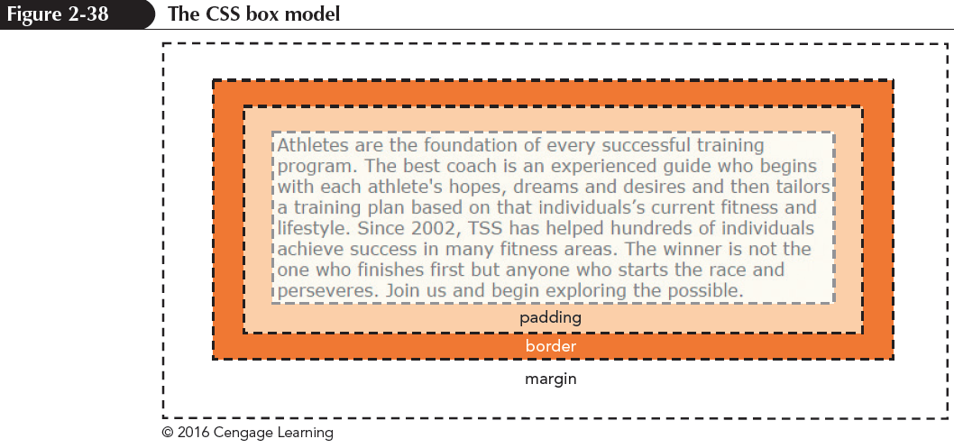
Working with Margins and Padding
The border surrounding the padding space
The margin space comprised of the space beyond the border up to the next page element

Slide 11
Setting the Padding Space
To set the width of the padding space, use the following padding property
padding: size;
Padding-top/right/bottom/left: size;
Padding: top right bottom left;
where size is expressed in one of the CSS units of length or the keyword auto to let the browser automatically choose the padding

Slide 12
Setting the Margin and the Border
To set the size of the margin around block-level elements, use
margin: size;
margin: top right bottom left;
To set the size of the border space, use
border-width: size;
border-width: top right bottom left;
border-color: color;
Border-style: style;

Slide 13
Using Pseudo-Classes and Pseudo-Elements
Pseudo-class – classifies an element based on its current status, position, or use in the document
element: pseudo-class
where element is an element from the document and pseudo-class is the name of a css pseudo-class
Structural pseudo-class – classifies an element based on its location within the structure of the HTML document

Slide 14
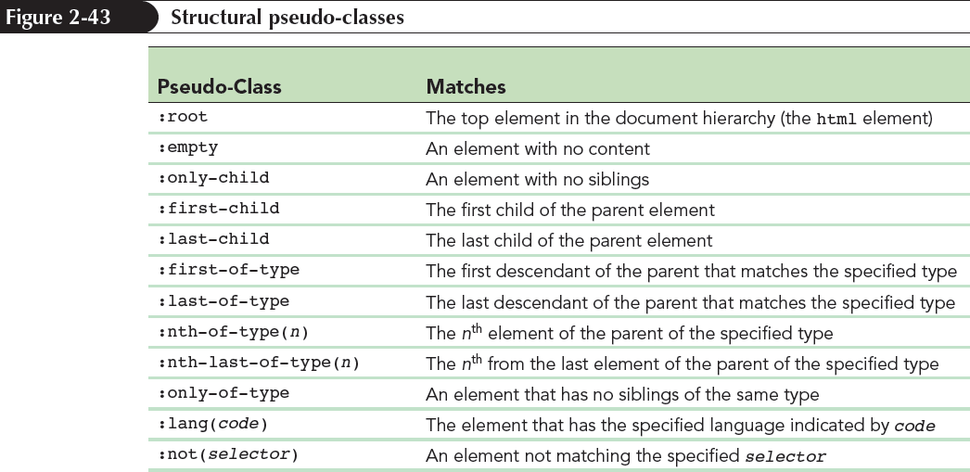
Using Pseudo-Classes and Pseudo-Elements

Slide 15
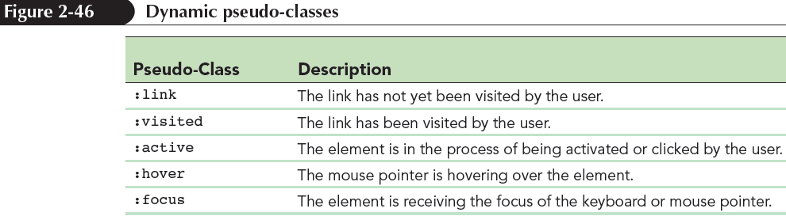
Pseudo-classes for Hypertext
Dynamic pseudo-class – A type of pseudo-class in which the class can change state based on the actions of the user

Slide 16
Pseudo-Elements
Pseudo-element – An object that exists only in the rendered page
Pseudo-elements can be selected using the following CSS selector:
element::pseudo-element
where element is an element from the HTML file and pseudo-element is the name of a CSS pseudo-element

Slide 17
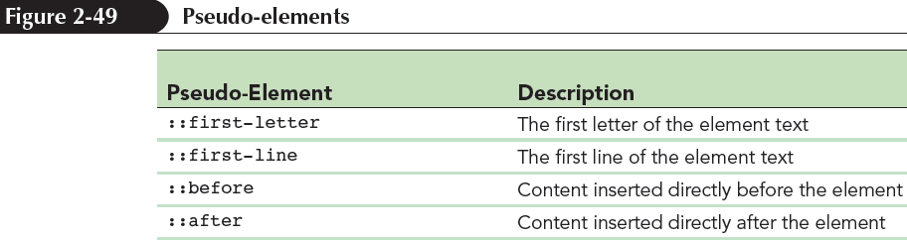
Pseudo-Elements

Slide 18
Tutorial 3 Designing a Web Page with CSS

Slide 19
Objectives
Create a reset style sheet
Explore page layout designs
Center a block element
Create a floating element
Clear a floating layout
Explore grid-based layouts

Slide 20
Objectives (continued)
Create a layout grid
Format a grid
Explore the CSS grid styles
Explore positioning styles
Work with relative positioning
Work with absolute positioning
Work with overflow content

Slide 21
Introducing the display Style
HTML elements are classified into
Block elements, such as paragraphs or headings
Inline elements, such as emphasized text or inline images
The display style can be defined for any page element using
display: type;
where type defines the display type

Slide 22
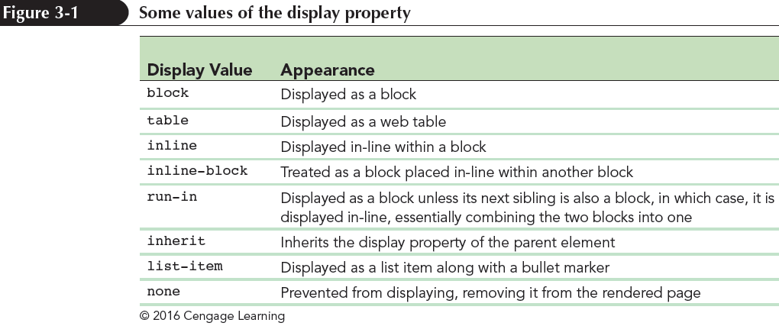
Introducing the display Style

Slide 23
Exploring Page Layout Designs
Web page layouts fall into three categories:
Fixed layout – Size of the page and page elements are fixed, usually using pixels as the unit of measure
Fluid layout – The width of the page elements are set as a percent of the available screen width. The page resizes automatically to match the screen resolution of the user’s device
Elastic layout – all measurements are in em units and based on the default font size used in the page. Images and text are always sized in proportion to each other.

Slide 24
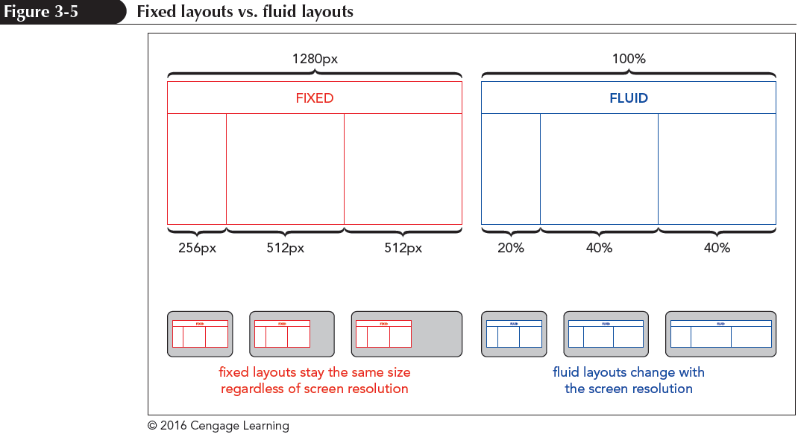
Exploring Page Layout Designs
Responsive design – The layout and design of a page changes in response to the device that is rendering it

Slide 25
Working with Width and Height
The width and height of an element are set using the following properties:
width: value;
height: value;
where value is the width or height using one of the CSS units of measurement or as a percentage of the width or height of the parent element
body{width: 95%}

Slide 26
Working with Width and Height
To set the minimum possible width or height of a block element, use the styles
min-width : value;
min-height : value;
To set the maximum possible width or height, use the styles
max-width : value;
max-height : value;

Slide 27
Centering a Block Element
Block elements can be centered horizontally within their parent element by setting both the left and right margins to auto
body {
margin-left: auto;
margin-right: auto;
}

Slide 28
Vertical Centering
Centering an element vertically can be accomplished by displaying the parent element as a table cell and setting the vertical-align property to middle
For example, to vertically center the following h1 heading within the div element:
<div>
<h1>Pandaisia Chocololates</h1>
</div>

Slide 29
Vertical Centering
Apply the style rule
div {
height: 40px;
display: table-cell;
vertical-align: middle;
}
Using this style rule, the h1 heading will be vertically centered

Slide 30
Floating Page Content
Floating an element takes it out of position and places it along the left or right side of its parent element
To float an element, apply
float: position;
where position is none (the default), left to float the object on the left margin or right to float the object on the right margin

Slide 31
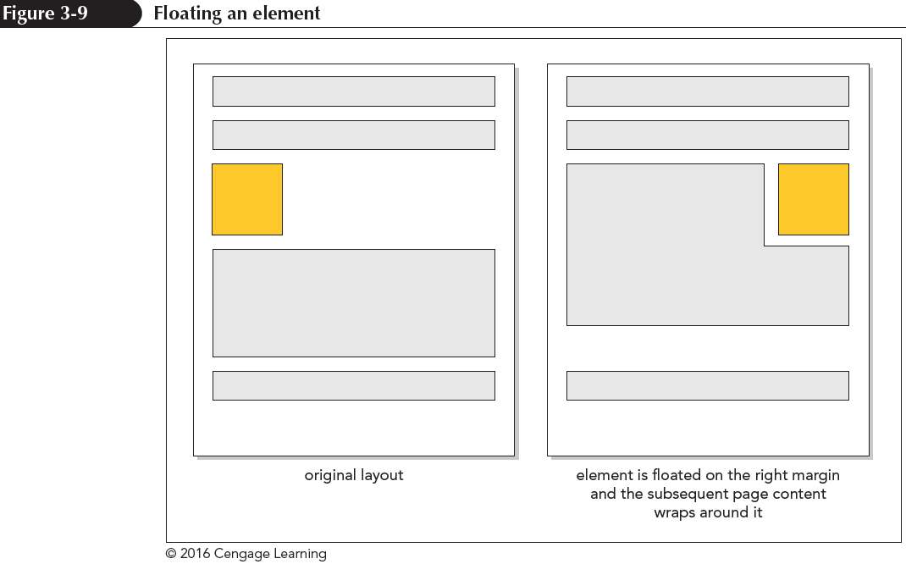
Floating Page Content
For elements to be placed within a single row, the combined width of the elements cannot exceed the total width of their parent element

Slide 32
Clearing a Float
To ensure that an element is always displayed below floated elements, use
clear: position;
where position is left, right, both, or none

Slide 33
Clearing a Float
left – Displays the element only when the left margin is clear of floating objects
right – Displays the element only when the right margin is clear of floating objects
both – Displays the element only when both margins are clear of floats
none – Displays the element alongside any floated objects

Slide 34
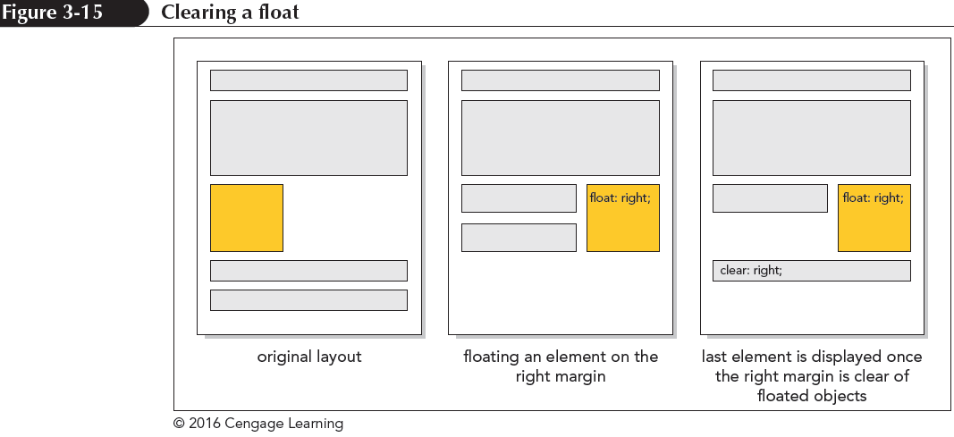
Clearing a Float

Slide 35
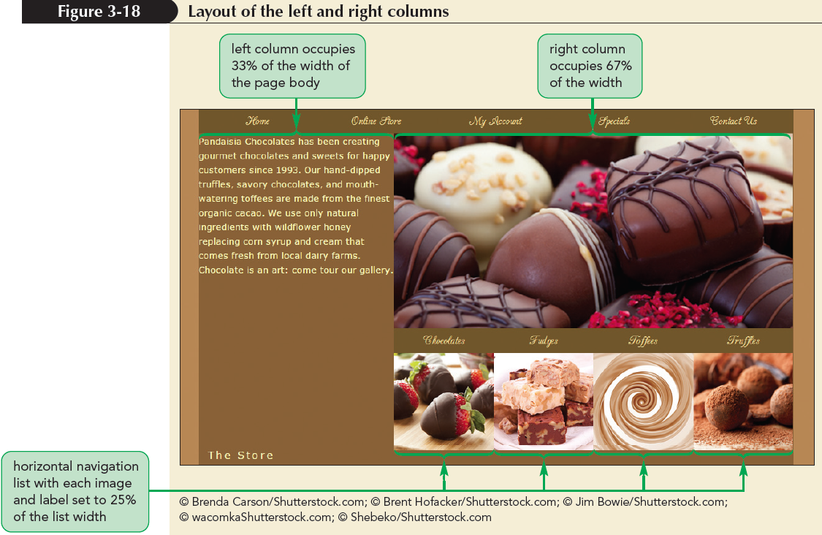
Clearing a Float

Slide 36
Refining a Floated Layout
Content box model – The width property only refers to the width of an element content and any padding or borders constitute added space
Border box model – The width property is based on the sum of the content, padding, and border spaces
Additional space taken up by the padding and border is subtracted from space given to the content

Slide 37
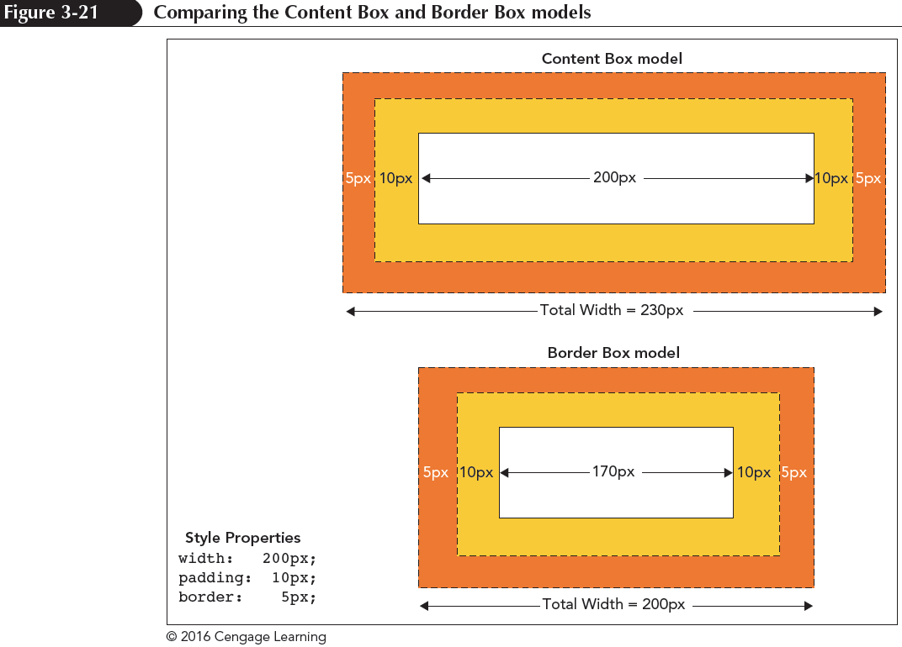
Refining a Floated Layout

Slide 38
Refining a Floated Layout
The layout model can be chosen using
box-sizing: type;
where type is content-box (the default), border-box, or inherit (to inherit the property defined for the element’s container)

Slide 39
Cont’d

